Slide 1


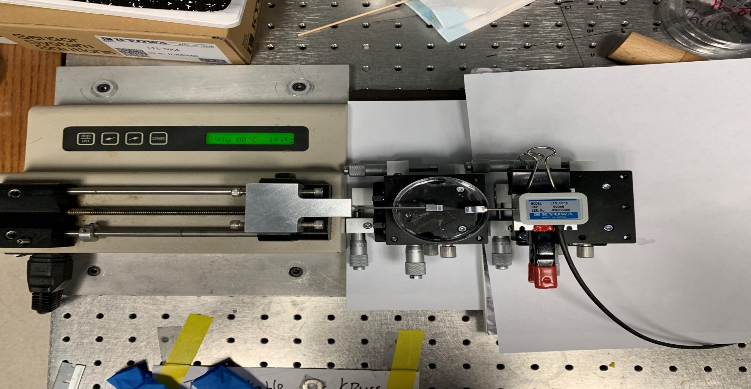
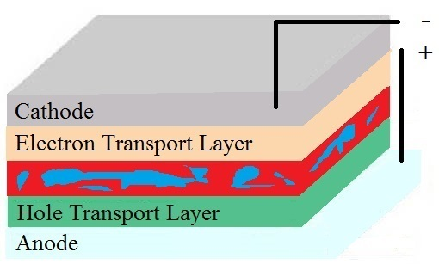
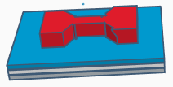

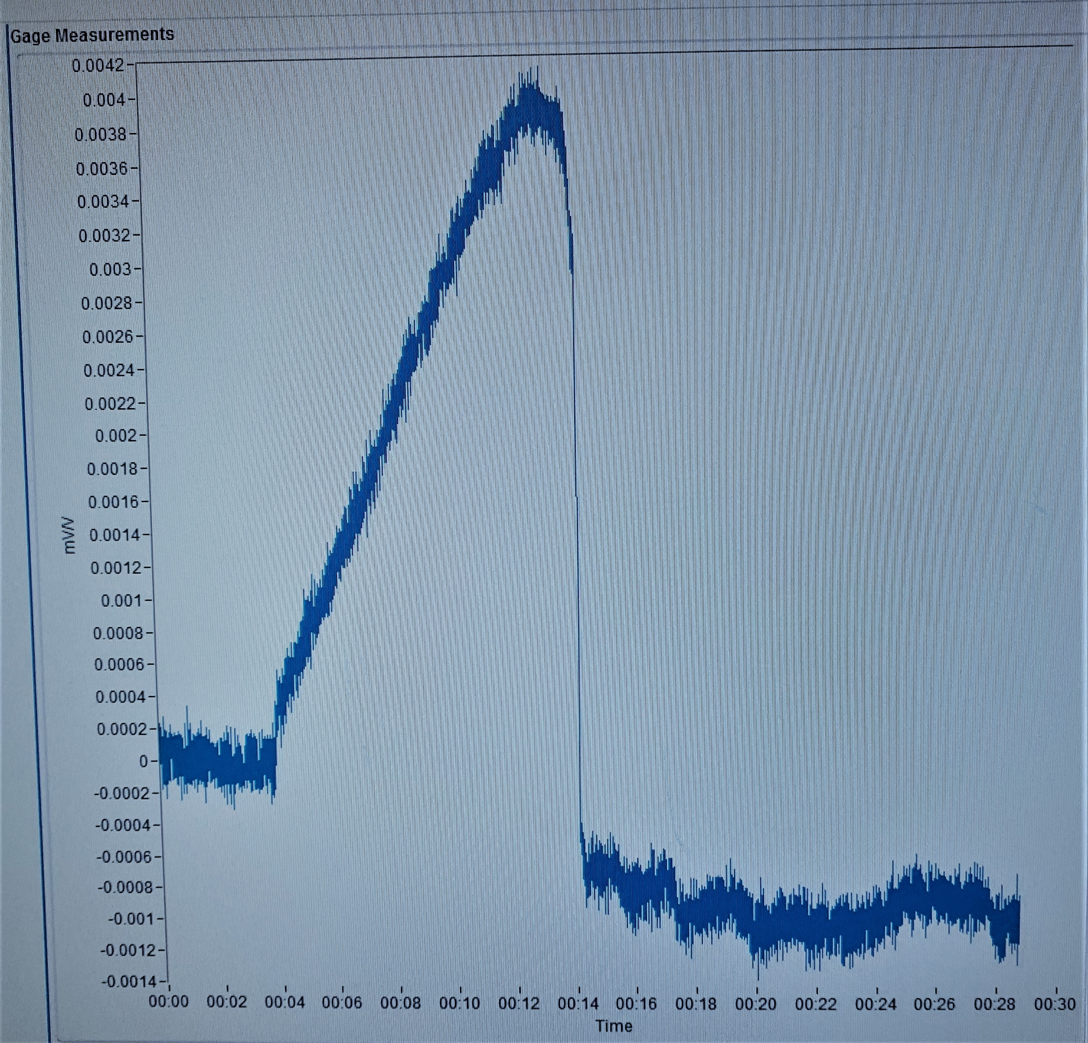
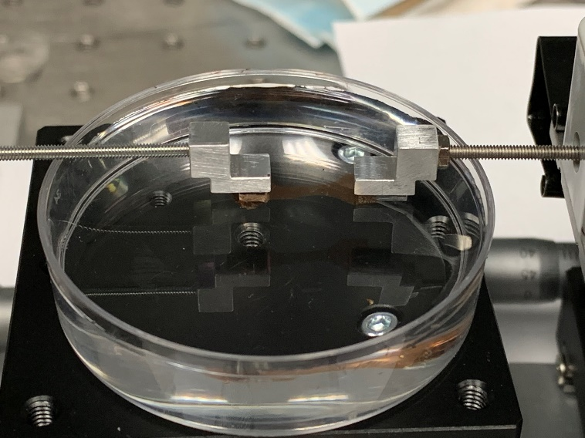

Understanding the Mechanical Properties of Thiolene Blended Active Layer Films for Organic Photovoltaics
Damilola Owolabi¹, Zhiqi Hu², Changxu Sun², Rafael Verduzco²
¹REEMS program, Houston Community College, Houston, Texas
²Department of Chemical and Biomolecular Engineering, Rice University, Houston , Texas
INTRODUCTION
EXPERIMENTAL
RESULTS AND CONCLUSION
Organic photovoltaics are thin, flexible devices that converts solar radiation to electrical efficiency
It boasts of many attractive features like its flexibility, easy integration to various devices, low manufacturing costs and easy processing, etc.
Flexible photovoltaics have lot of potential applications in soft robotics and wearable electronics.
Our goal is to test mechanical properties of cross-linked thiolene network (PETMP-PAE) in making flexible devices, when blended with different percentages of the active layer film.
Schematics of the Floating Device
Mechanical Properties of Thiolene blended with P3HT:PCBM
Goal: To measure the stress, strain and elastic modulus on the active layer blended with different percentages of Thiolene using the floating device.
Making the Film
Poly( 3-hexylthiopene) (P3HT) - Donor
Load cell
The film
Syringe pump
Active Layer
Device Calibration
Phenyl C₆₁ butyric acid methyl Esther (PCBM) - Acceptor
e-
The device consists mainly of The syringe pump which stretches the film and the load cell which measures the force applied on the film.
Syringe pump calibration
Load cell calibration
P3HT and PCBM are mixed together to form the active layer. The active layer is used for charge separation, charge transfer and light absorption. But it is fragile.
CONCLUSIONS
Flexible cross-linked thiolene network formation
Thiolene reduces the stress of the active layer and makes it more elastic.
There is a linear decrease on the maximum stress and elastic modulus with every increase on the percentage of thiolene blended with the active layer.
There is an exponential increase on the crack on set strain with every increase on the percentage of thiolene blended with the active layer.
Pentaerythritol tetra(3-mercaptopropionate) PETMP
Pentaerythritol allyl ether PAE
=
=
The syringe pump is calibrated by recording the average displacement velocity of the device, as it was initially in volumetric rate
The load cell is calibrated by finding the relationship between the weight of the PDMS and the cell voltage measured on the device
Thiol Group
Vinyl Group
FUTURE WORKS
Perform floating tests on thiolene blended with pristine P3HT and pristine PCBM
Run a simulation in molecular level to further understand how thiolene network interacts with the active materials
Optimized thiolene content that will balance both mechanical and electronic properties of the active layer
Schematic of the thiolene network
The PETMP has 4 thiol end groups, while PAE has 3 vinyl groups. They cross-link to form a network within the active layer.
Measuring the Crack Onset Strain Of thiolene crosslinked active layer
UV Plasma
Transferring to water
Active layer
Dog-bone shaped PDMS block
Water
REFERENCES
Active layer
GLASS
1. Blend
2. Deposit
3. Crosslink
Polystyrene sulfonate (PSS)
The PSS dissolves in water and the glass sinks to the bottom, while the active layer floats
Chem. Mater.201830228314-8321,Publication Date : October 26, 2018
https://doi.org/10.1021/acs.chemmater.8b03791.
Glass
Donor
UV Radiation
ACKNOLEDGEMENTS
Acceptor
Dr. Rafael Verduzco (Primary Investigator)
Dr. John J. Vaselli, Dean of Engineering Centre of Excellence, Houston Community College
Mrs. Mary Hurd, Houston Community College
My teammates Zhiqi Hu and Changxu Sun and the entire Verduzco Laboratory
Shared Equipment Authority (SEA), Rice University
Financial support; NSF DMR 1460564.
PETMP
+ PAE
PETMP and PAE form the thiolene by crosslinking under UV radiation. This makes the devices flexible.
The cell voltage rises overtime as the film stretches, then falls as the film cracks.
Cracked film
The film cracks under stretching
Film was held in place by PDMS, then stretched

